Slide 1









OPEN-SOURCE
MRI SEQUENCE
PROGRAMMING
WORKSHOP
Fat Separators
26th September 2025 | Authors and affiliations: Ekin Taskin (EPFL, Lausanne, Switzerland), Salomé Baup (EPFL, Lausanne, Switzerland), Jacopo Frignani (Orbem),*
*With the data analysis help of Berk Can Acikgoz
SEP 24-26, 2025
Multi-echo sequence for fat-water separation
Notes:
Good morning everyone! On behalf of the organizing committee - Milena, Eva, Joe, Piotr, and me - I would like to welcome you all in Bern and to the Open Source MRI Sequence Programing Workshop! Thank you for coming all the way here and for your interest in this workshop!

Slide 2
OPEN-SOURCE
MRI SEQUENCE
PROGRAMMING
WORKSHOP
SEP 24-26, 2025
Project Goal
Reply to the following questions:
For what could your Pulseq sequence be used for if it would be fully developed?
Fat-water separation
What are people currently using because they don’t have your Pulseq sequence available and what are the disadvantages of this technique?
Non-Pulseq Multi Echo GRE: harder to implement/improve on the specific vendors
What steps have to be done to develop your Pulseq sequence?
Single-echo GRE → Multi-echo GRE, protocol tuning

Slide 3
OPEN-SOURCE
MRI SEQUENCE
PROGRAMMING
WORKSHOP
SEP 24-26, 2025
Path to Current Implementation
Design a flowchart on how you implemented your Pulseq sequence. The flow chart below is just an example.
Gre
Pulseq GRE tutorials
+
Dixon FWS theory
Multi echo sequence design
Data acquisition at 3T
fe
Data processing
Results

Slide 4
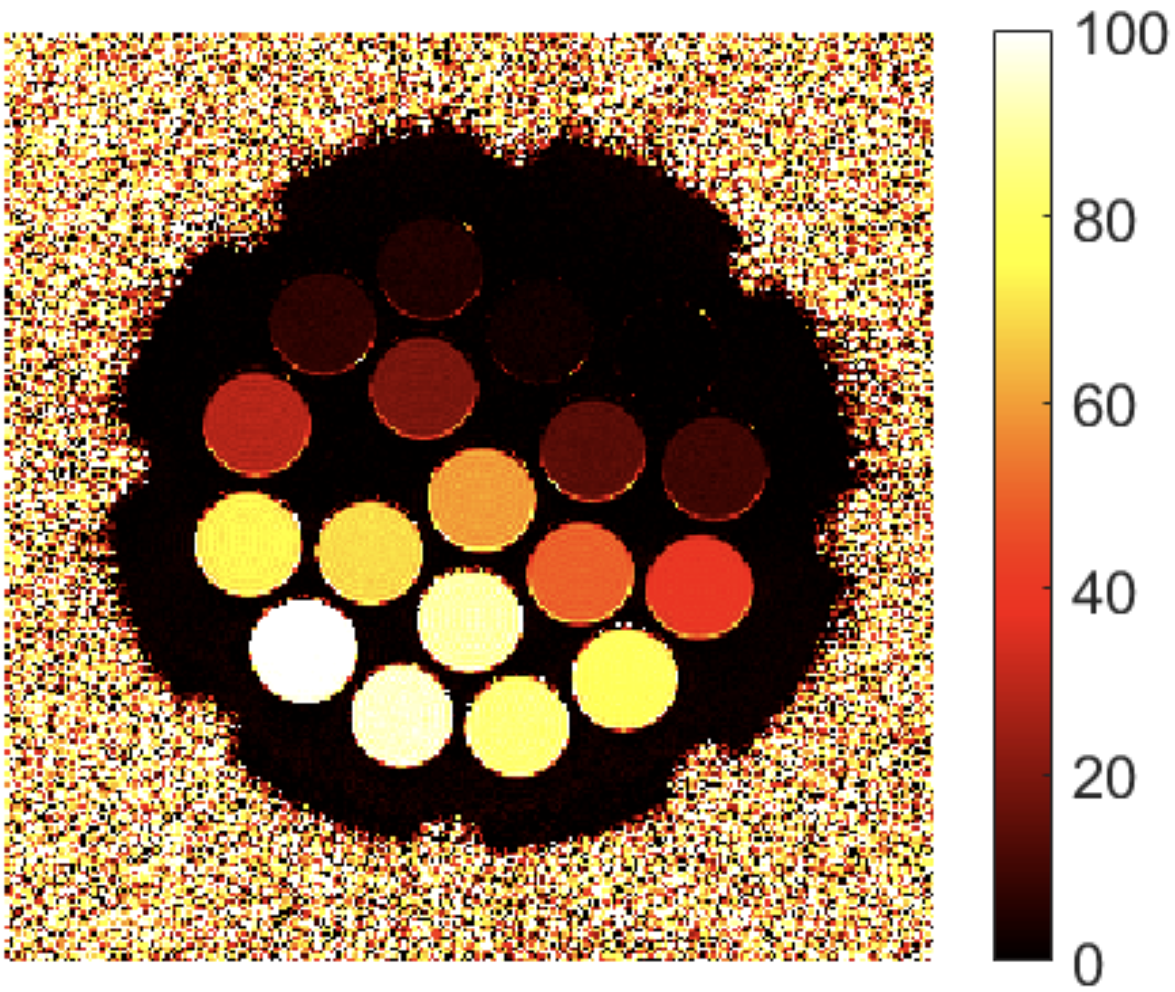
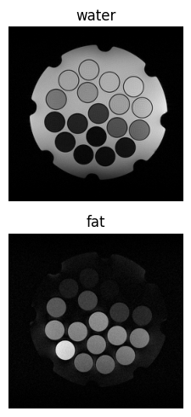
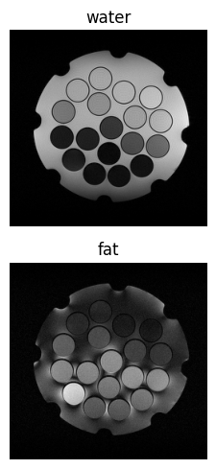
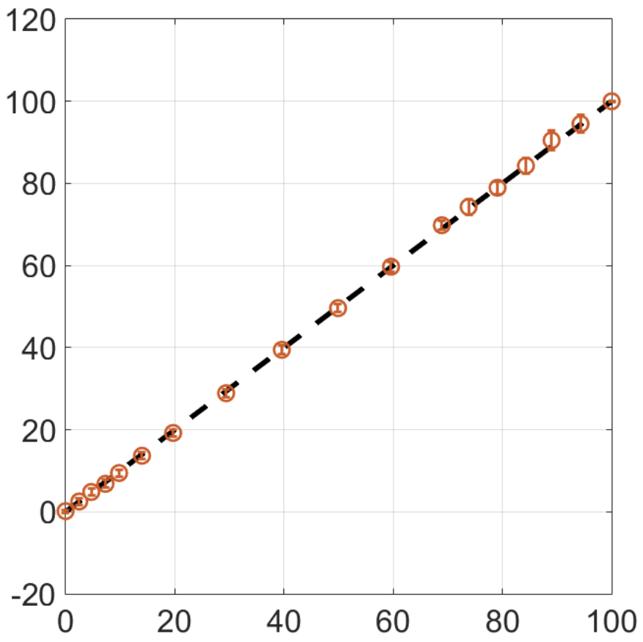
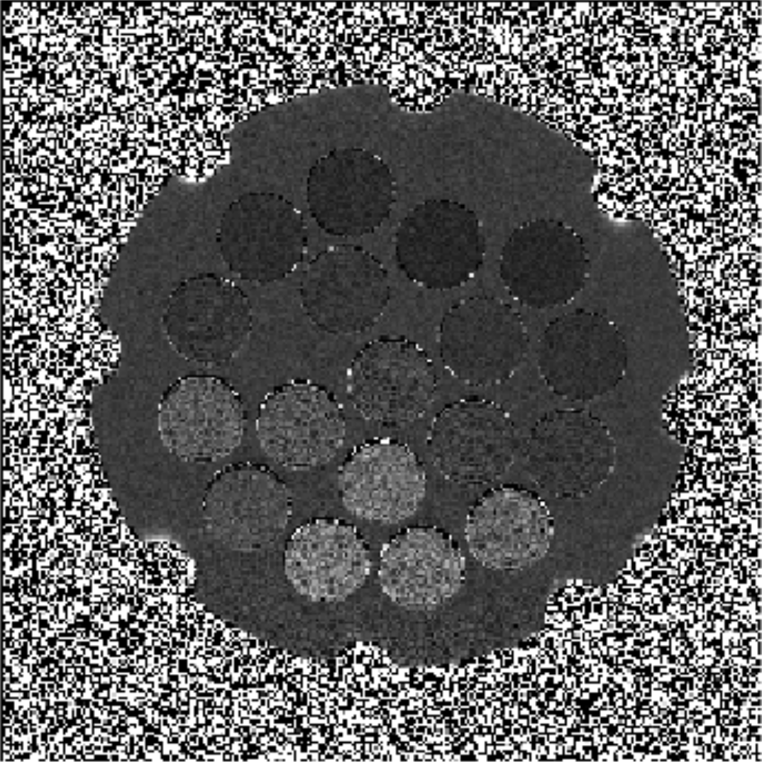
OPEN-SOURCE
MRI SEQUENCE
PROGRAMMING
WORKSHOP
SEP 24-26, 2025
Preliminary Results
Fat fraction
v
Echo spacing 1.15 ms
Echo spacing 5.75 ms
T2*

Slide 5
OPEN-SOURCE
MRI SEQUENCE
PROGRAMMING
WORKSHOP
SEP 24-26, 2025
Outlook
Reply to the following questions:
What are the next recommended steps in your Pulseq project?
Achieve shorter TE/echo spacing → bipolar echoes, readout PF, gradient sampling, bipolar echoes. Speed up the sequence → multi-shot multi-echo GRE. Tune the protocol parameter.
What did you learn when using Pulseq?
Using Pulseq! (easier sequence programming, easier sequence testing)
Do you have any suggestions to improve Pulseq?
Enable UI for protocol parameter change
Insert the GitHub link to your project results here: https://github.com/QIS-MRI/Pulseq_Workshop/___________

